Slide 1
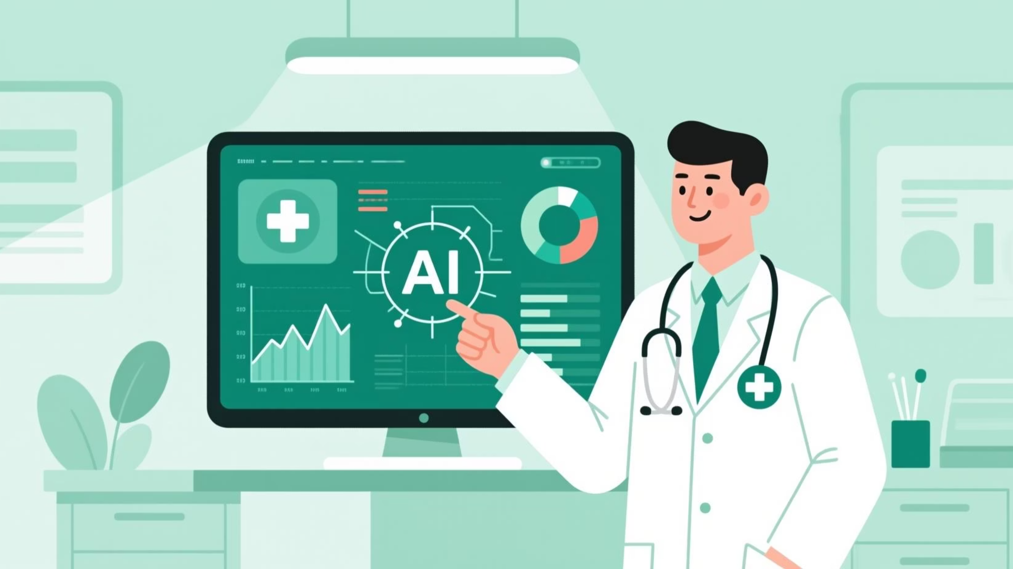
Vital.AI: Intelligent Clinical Decision Support
Vital.AI transforms complex patient data into rapid, actionable diagnostic insights, empowering medical professionals to make faster, more accurate clinical decisions.
Team: Code-Crackers

Slide 2
Vital.AI: Intelligent Clinical Decision Support
Vital.AI transforms complex patient data into rapid, actionable diagnostic insights, empowering medical professionals to make faster, more accurate clinical decisions.
Team: Code-Crackers

Slide 3
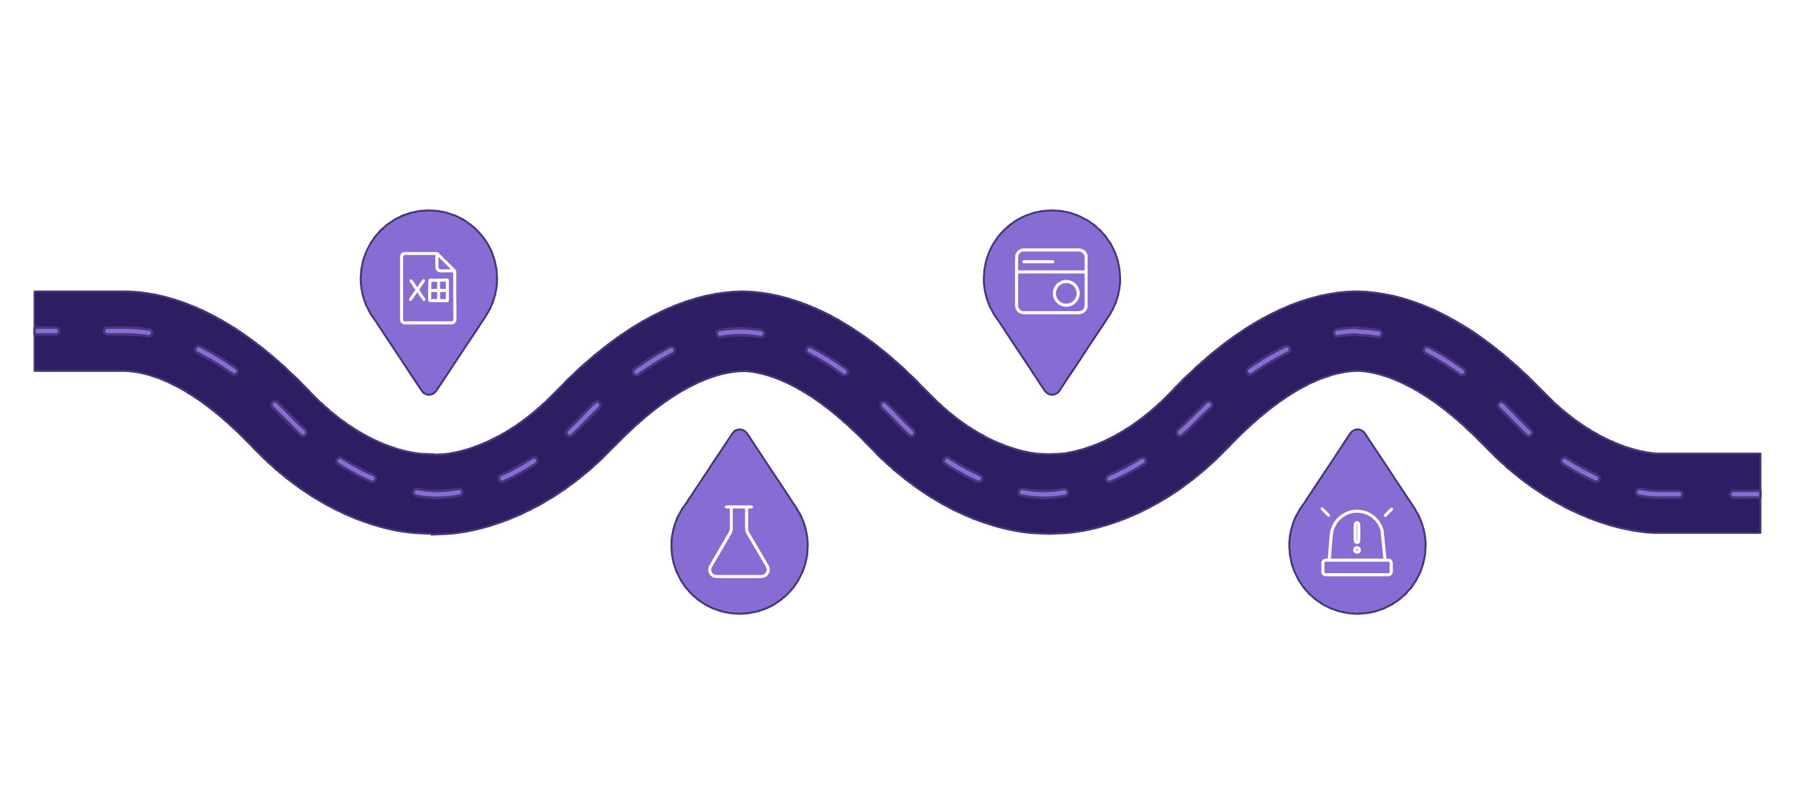




1 in 10 diagnoses are incorrect, impacting patient care.
The Problem: Diagnostic Bottleneck
The High Cost of Manual Diagnosis
Delayed diagnosis is deadly, especially for time-sensitive conditions like cancer.
Manual review of patient data is slow and error-prone.
PaperworkManual forms and patient files pile up
Doctor ReviewTime-consuming manual interpretation
OutcomeDelayed or incorrect diagnosis
Lab ReportsSlow results and fragmented data

Slide 4
The Problem: Diagnostic Bottleneck
The High Cost of Manual Diagnosis
Manual review of patient data is slow and error-prone.
1 in 10 diagnoses are incorrect, impacting patient care.
Delayed diagnosis is deadly, especially for time-sensitive conditions like cancer.
PaperworkManual forms and patient files pile up
Doctor ReviewTime-consuming manual interpretation
Lab ReportsSlow results and fragmented data
OutcomeDelayed or incorrect diagnosis

Slide 5
Lab results
Structured test data
Solution: AI Clinical Co-Pilot
Augmenting Expertise, Not Replacing It
What it is:
Who it's for:
Core Value:
AI-driven analysis of patient data (lab results, biometrics) for rapid diagnostic insights.
Clinicians seeking powerful, data-driven decision support.
Streamlines workflow, boosts accuracy, and provides critical 'second opinion' support.
Diagnostic insight
Patient file
Clear clinician guidance
Medical history & notes
Vital.AI
Symptoms
Aggregates and analyzes
Reported clinical signs

Slide 6

Solution: AI Clinical Co-Pilot
Augmenting Expertise, Not Replacing It
What it is:
Who it's for:
Core Value:
AI-driven analysis of patient data (lab results, biometrics) for rapid diagnostic insights.
Clinicians seeking powerful, data-driven decision support.
Streamlines workflow, boosts accuracy, and provides critical 'second opinion' support.
Lab results
Structured test data
Diagnostic insight
Patient file
AI Clinical Co‑Pilot
Medical history & notes
Clear clinician guidance
Vital.AI
Symptoms
Aggregates and analyzes
Reported clinical signs

Slide 7
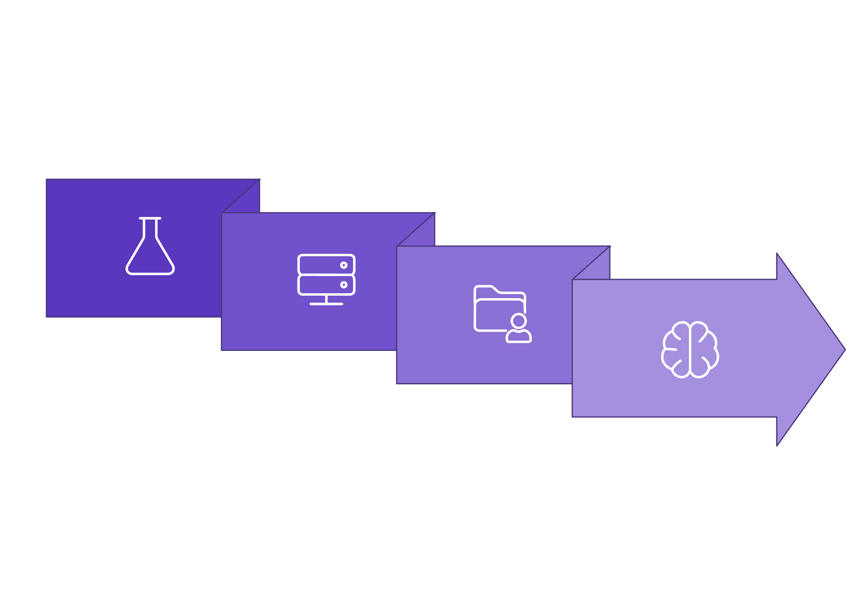
Backend
Manages data, logic & AI model communication.
Inference Engine
Generates accurate diagnostic predictions.
Vital.AI's Core Engine
How AI System Works
Data Processing
Frontend
Cleans, validates & prepares data for AI.
Intuitive interface for data input.

Slide 8
Vital.AI's Core Engine
How AI System Works
Backend
Manages data, logic & AI model communication.
Inference Engine
Generates accurate diagnostic predictions.
Frontend
Intuitive interface for data input.
Data Processing
Cleans, validates & prepares data for AI.

Slide 9




Vital.AI's Engine: Powering Precision
Built for Accuracy & Speed
Language: Python
Data Science: Pandas, NumPy, Scikit-learn
Web Framework: Streamlit
Foundation for AI. Robust data science & ML ecosystem.
Core for data. Manipulation, computation, ML modeling.
Rapid UI. Quick prototyping & app deployment.
ML Model: Random Forest / XGBoost
Visualization: Plotly / Matplotlib
Accurate predictions. Efficient, reliable diagnostic AI.
Clear insights. Dynamic data visualization for medical clarity.

Slide 10
Vital.AI's Engine: Powering Precision
Data Science: Pandas, NumPy, Scikit-learn
Built for Accuracy & Speed
Core for data. Manipulation, computation, ML modeling.
Language: Python
Foundation for AI. Robust data science & ML ecosystem.

Slide 11
Vital.AI's Engine: Powering Precision
Built for Accuracy & Speed
Language: Python
Data Science: Pandas, NumPy, Scikit-learn
Foundation for AI. Robust data science & ML ecosystem.
Core for data. Manipulation, computation, ML modeling.
Web Framework: Streamlit
Rapid UI. Quick prototyping & app deployment.
ML Model: Random Forest / XGBoost
Visualization: Plotly / Matplotlib
Accurate predictions. Efficient, reliable diagnostic AI.
Clear insights. Dynamic data visualization for medical clarity.

Slide 12
Vital.AI's Engine: Powering Precision
Built for Accuracy & Speed
Language: Python
Data Science: Pandas, NumPy, Scikit-learn
Web Framework: Streamlit
Foundation for AI. Robust data science & ML ecosystem.
Core for data. Manipulation, computation, ML modeling.
Rapid UI. Quick prototyping & app deployment.
ML Model: Random Forest / XGBoost
Visualization: Plotly / Matplotlib
Accurate predictions. Efficient, reliable diagnostic AI.
Clear insights. Dynamic data visualization for medical clarity.

Slide 13
Vital.AI's Engine: Powering Precision
Built for Accuracy & Speed
Language: Python
Data Science: Pandas, NumPy, Scikit-learn
Web Framework: Streamlit
Foundation for AI. Robust data science & ML ecosystem.
Core for data. Manipulation, computation, ML modeling.
Rapid UI. Quick prototyping & app deployment.
ML Model: Random Forest / XGBoost
Visualization: Plotly / Matplotlib
Accurate predictions. Efficient, reliable diagnostic AI.
Clear insights. Dynamic data visualization for medical clarity.

Slide 14
Vital.AI's Engine: Powering Precision
Built for Accuracy & Speed
Language: Python
Data Science: Pandas, NumPy, Scikit-learn
Web Framework: Streamlit
Foundation for AI. Robust data science & ML ecosystem.
Core for data. Manipulation, computation, ML modeling.
Rapid UI. Quick prototyping & app deployment.
ML Model: Random Forest / XGBoost
Visualization: Plotly / Matplotlib
Accurate predictions. Efficient, reliable diagnostic AI.
Clear insights. Dynamic data visualization for medical clarity.

Slide 15

The Core Predictive Model
Training the AI Brain for Impact
Robust Data Foundation
Intelligent Model Choice
Proven Accuracy
Trained on a comprehensive, public dataset for accurate disease onset prediction.
Random Forest Classifier selected for high performance and crucial interpretability.
Achieved 92% accuracy, effectively identifying critical disease patterns.
This performance translates directly to earlier detection and better patient outcomes.

Slide 16
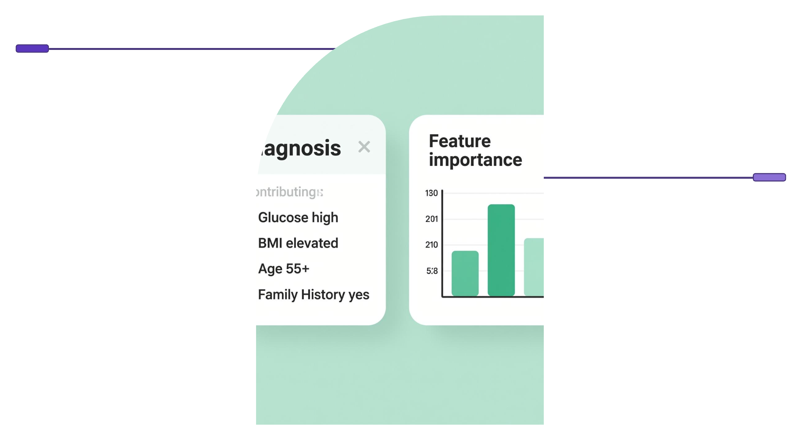
Key Feature: Explainable AI (XAI)
From "Black Box" to Transparent Assistant
The Problem:
The Solution:
The Benefit:
AI's 'black box' problem: Predictions are useless if doctors don't understand the 'why'.
XAI provides a 'treasure map,' highlighting key factors (e.g., Glucose, BMI) behind each prediction.
Builds trust, enables clinical verification, and empowers doctors to explain results confidently.
Predicted Diagnosis
Predicted: Type 2 Diabetes
Feature Importance
Glucose, BMI, Age, Family History

Slide 17
Key Feature: Explainable AI (XAI)
From "Black Box" to Transparent Assistant
The Problem:
The Solution:
The Benefit:
AI's 'black box' problem: Predictions are useless if doctors don't understand the 'why'.
XAI provides a 'treasure map,' highlighting key factors (e.g., Glucose, BMI) behind each prediction.
Builds trust, enables clinical verification, and empowers doctors to explain results confidently.
Predicted Diagnosis
Predicted: Type 2 Diabetes
Feature Importance
Glucose, BMI, Age, Family History

Slide 18
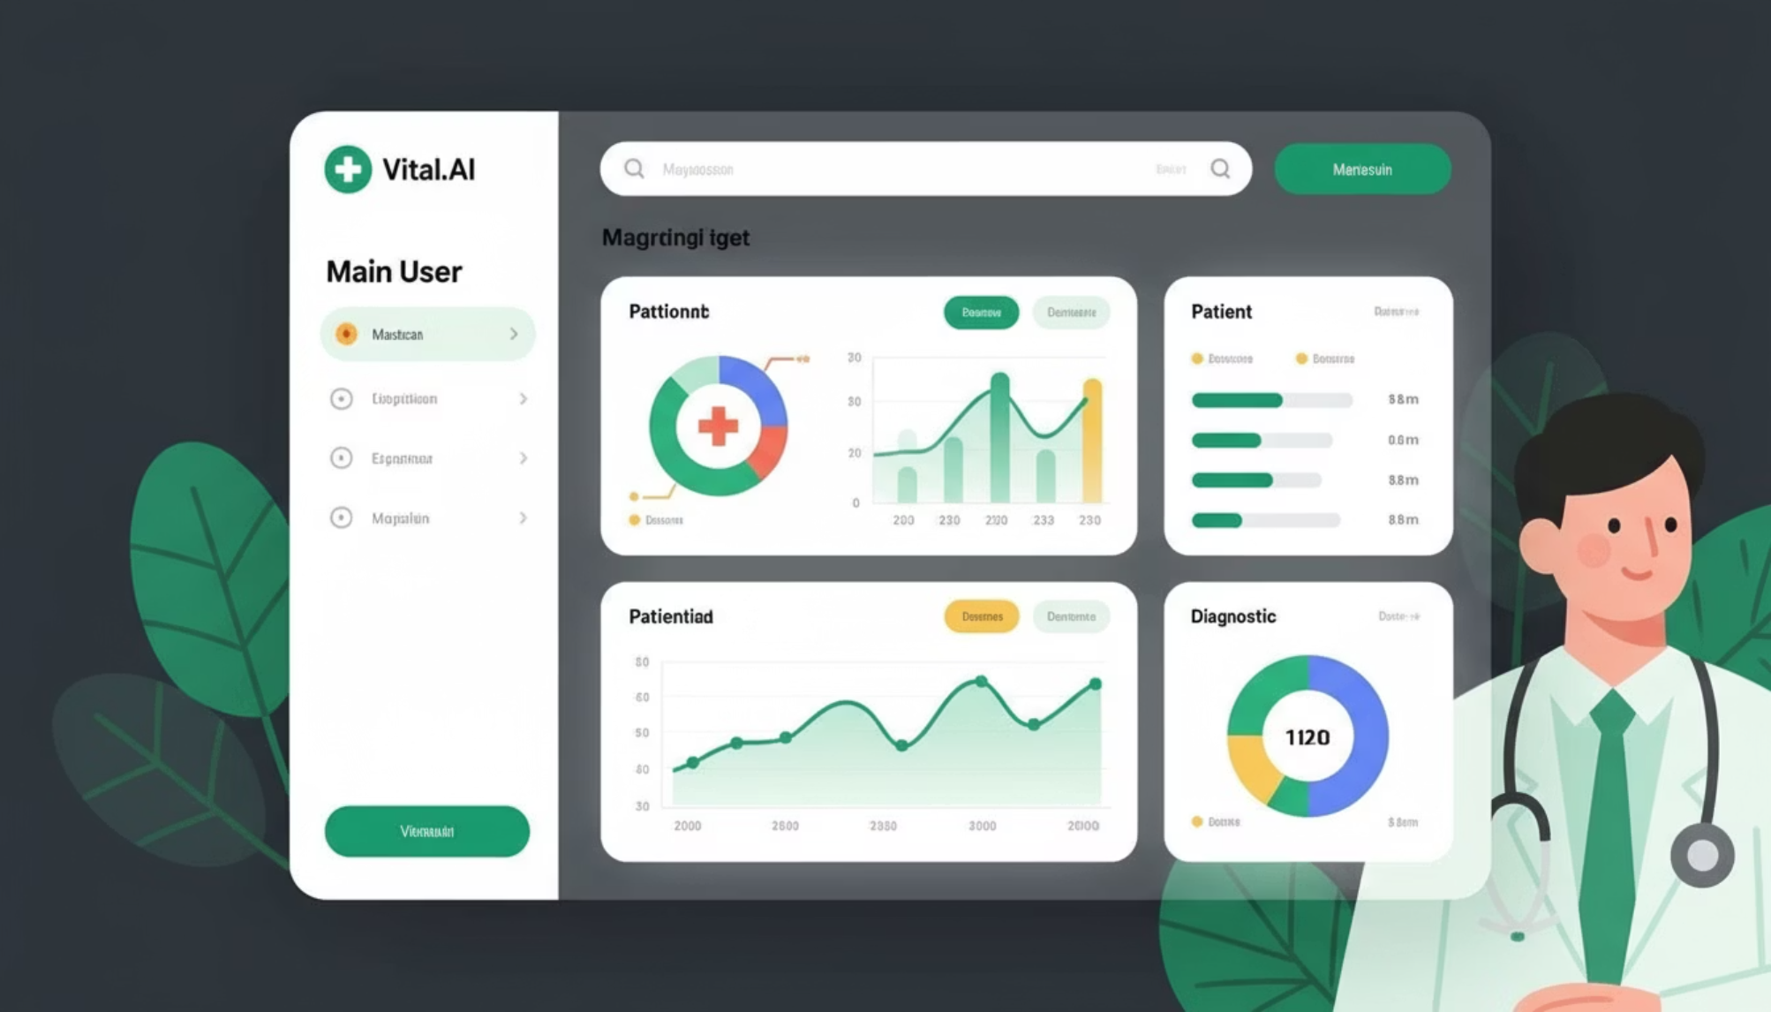
Live Demo
Vital.AI in Action
Witness Vital.AI in action: transforming complex lab data into real-time, actionable insights. Explore the intuitive interface and powerful diagnostic visualizations here: Vital.AI Live Demo

Slide 19

Vision: Accelerated Health
Transformative Impact
Long-Term Vision
Significantly reduce diagnostic errors.
Immediate Next Steps
Multi-modal AI: Combine lab data + medical imaging.
Integrate diverse datasets for broader disease insight.
Drastically improve patient outcomes.
Seamless EHR integration for rapid deployment.
Automate lab report analysis via OCR.
Boost healthcare efficiency and savings.

Slide 20
Vision: Accelerated Health
Transformative Impact
Long-Term Vision
Significantly reduce diagnostic errors.
Immediate Next Steps
Multi-modal AI: Combine lab data + medical imaging.
Integrate diverse datasets for broader disease insight.
Drastically improve patient outcomes.
Seamless EHR integration for rapid deployment.
Automate lab report analysis via OCR.
Boost healthcare efficiency and savings.

Slide 21
Vision: Accelerated Health
Transformative Impact
Long-Term Vision
Significantly reduce diagnostic errors.
Immediate Next Steps
Multi-modal AI: Combine lab data + medical imaging.
Integrate diverse datasets for broader disease insight.
Drastically improve patient outcomes.
Seamless EHR integration for rapid deployment.
Automate lab report analysis via OCR.
Boost healthcare efficiency and savings.

Slide 22
Vision: Accelerated Health
Transformative Impact
Long-Term Vision
Significantly reduce diagnostic errors.
Immediate Next Steps
Multi-modal AI: Combine lab data + medical imaging.
Integrate diverse datasets for broader disease insight.
Drastically improve patient outcomes.
Seamless EHR integration for rapid deployment.
Automate lab report analysis via OCR.
Boost healthcare efficiency and savings.

Slide 23

Thank You
Ready to Innovate Healthcare?
We believe solution can make a real difference. We're excited to partner and discuss next steps!
Questions? Let's connect!

